Slide 1

Investment in the Stock Market
Investment based on S&P 500 :
is it too obvious to get rich?
DS 5610 | Exploratory Data Analysis
Sit Dolor Amet

Slide 2
Introduction
S&P 500 Index:
Tracks stock performance
Top 500 U.S. companies
Benchmark for U.S. equity market
Motivation:
Identifying most profitable sectors
Historical trends as investment basis
Correlation with economic indicators

Slide 3
Datasets
Kaggle
Panel Dataset
Timeline (2018 - 2023)
Company and sector wise monthly returns, stock volumes, prices etc.
yfinance
Overall stock performance
3. Bureau of Labor Statistics
Unemployment Rate

Slide 4
Investment in the Stock Market
Exploratory
Analysis
Sit Dolor Amet

Slide 5
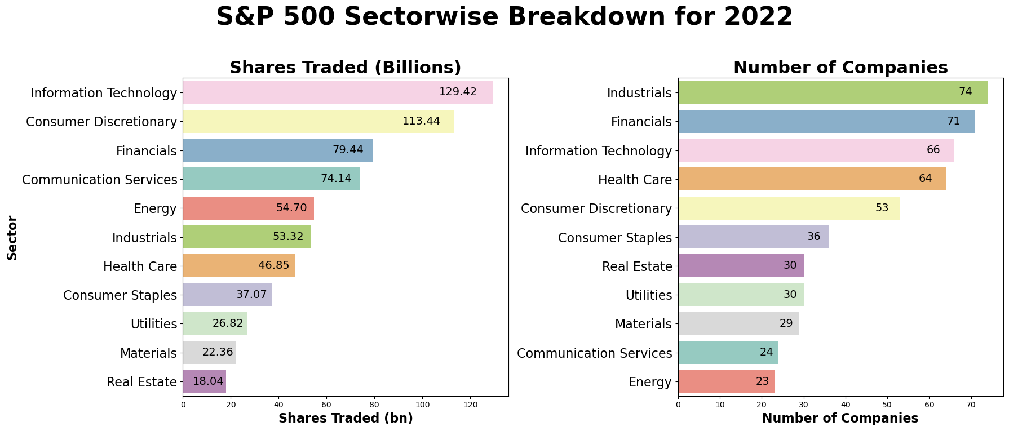
High trade volume ≠ High company count
Possible larger firms’ dominance in trading activity
Diversity between top companies of the U.S.

Slide 6
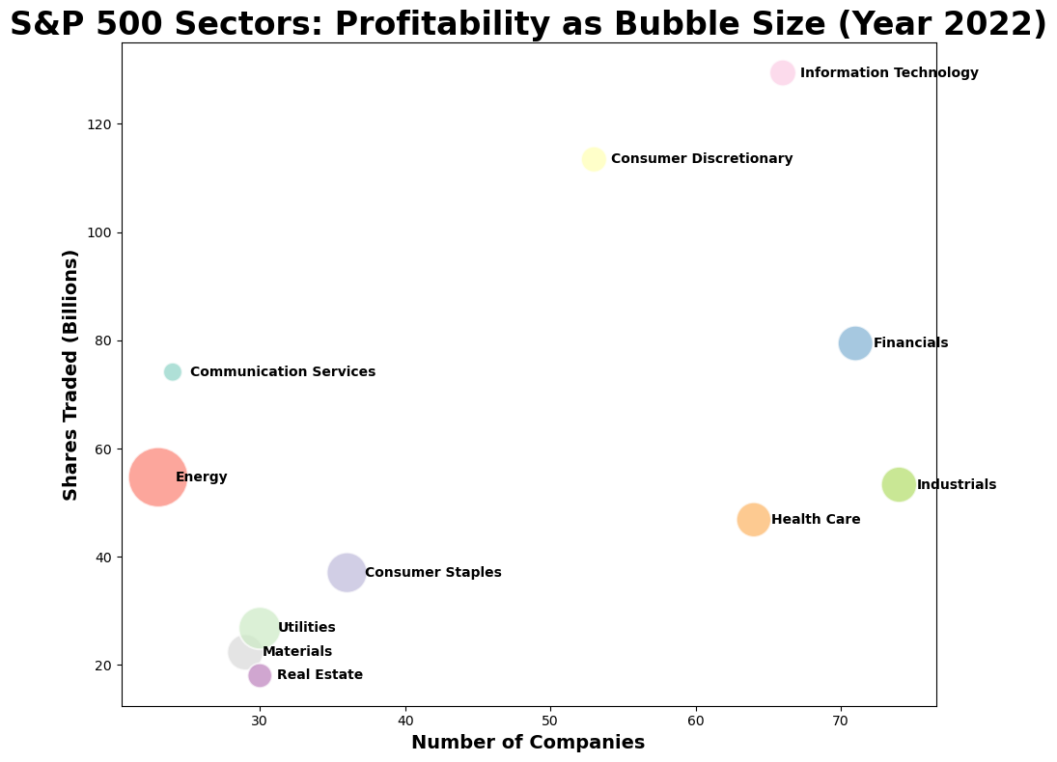
GICS Sector | Profitability | Number of Companies | Shares Traded (Billions)
Energy | 4.79% | 23 | 54.70
Utilities | 0.70% | 30 | 26.82
Consumer Staples | 0.35% | 36 | 37.07
Materials | -0.41% | 29 | 22.36
Industrials | -0.46% | 74 | 53.32
Financials | -0.54% | 71 | 79.44
Health Care | -0.61% | 64 | 46.85
Information Technology | -1.77% | 66 | 129.42
Consumer Discretionary | -1.85% | 53 | 113.44
Real Estate | -2.01% | 30 | 18.04
Communication Services | -2.57% | 24 | 74.14
Energy Sector: high profitability, fewer companies, medium trade volume
Information Technology: low profitability, numerous companies, high trade volume
Difference in profitability among sectors in a particular year

Slide 7
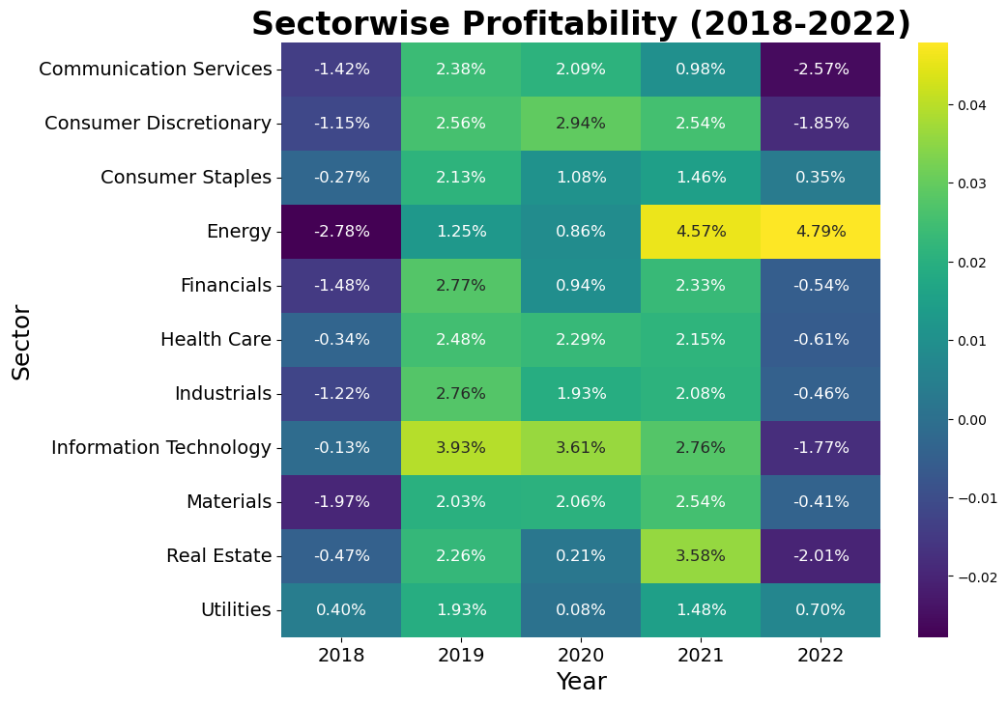
Market Unpredictable: Recent profits in sectors like Energy don't guarantee future success
Quick Changes: Sectors can shift quickly, as seen with Real Estate's drop after a profitable year
Investment Caution: Relying solely on past performance is risky due to many influencing factors

Slide 8
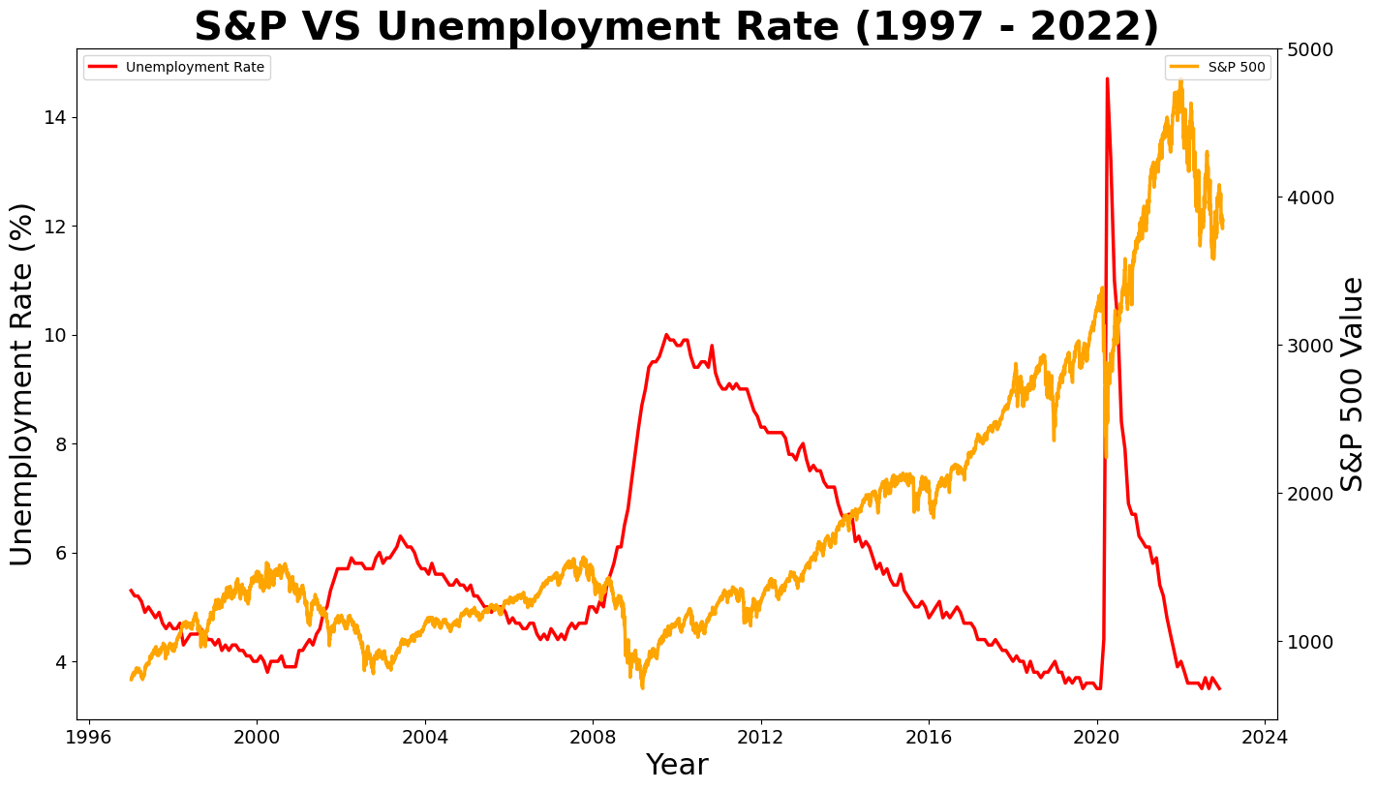
S&P 500 VS Unemployment Rate
Weak negative correlation
(Pearson Correlation Co-efficient = -0.276)
Statistically significant
(P value = 7.652 e-07)

Slide 9
Key Takeaways
High profitability of the energy sector in recent years
Substantial fluctuation in profitability across different sectors in different years
Investment decisions are challenging
Close connection between stock market and unemployment rate

